Slide 1
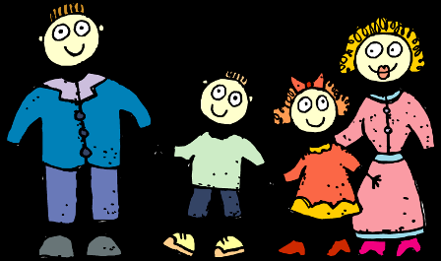
CHAPTER –VI
Agents OF SOCIALIZATION

Slide 2
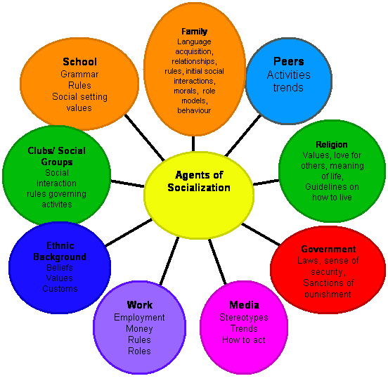

Slide 3
DEFINING SOCIALIZATION....
How do we learn to interact with other people? Socialization is a lifelong process during which we learn about social expectations and how to interact with other people.
Nearly all of the behaviour that we consider to be 'human nature' is actually learned through socialization. And it is during socialization that we learn how to walk, talk, and feed ourselves, about behavioural norms that help us fit in to our society, and so much more.

Slide 4
DEFINING SOCIALIZATION....
Socialization agents are the sources from which we learn about society and ourselves.
People and groups that influence our self-concept, emotions, attitudes, and behaviour are called agents of socialization.
Socialization occurs throughout our life, but some of the most important socialization occurs in childhood. So let's talk about the most influential agents of socialization. These are the people or groups responsible for our socialization during childhood - including family, school, peers, and mass media.

Slide 5
NEED FOR SOCIALIZATION
Socialization consist of teaching each individual the culture which he must acquire and share, of making him a participating member in society.
Socialization is a matter of learning and not of biological inheritance.
In the socialization process the individual learns the folkways, traditions and other patterns of culture as well as skills which will enable him to become a participating member of the human society.

Slide 6
FAMILY AS AN AGENT OF SOCIALIZATION
There is no better way to start than to talk about the role of family in our social development, as family is usually considered to be the most important agent of socialization.
As infants, we are completely dependent on others to survive. Our parents, or those who play the parent role, are responsible for teaching us to function and care for ourselves.
The family influences the child in the earliest stage of development. It is within the family that the child learns language and begins to internalize the norms and values.

Slide 7
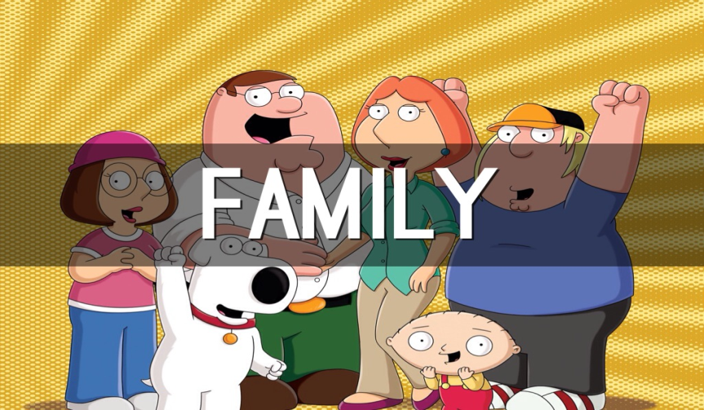
FAMILY AS AN AGENT OF SOCIALIZATION
The family is a primary group. The family teach us about close relationships, group life, and how to share resources. Additionally, it provide us with our first system of values, norms, and beliefs - a system that is usually a reflection of their own social status, religion, ethnic group, and more.
Within the family, the child passes through several stages of socialization. At each stage, the family members transmit culture to the child in different ways:

Slide 8
FAMILY AS AN AGENT OF SOCIALIZATION
At the infancy stage: The child is socialized largely by the mother. Her role is primarily that of nurture and protection.
Stage of emergence of self: The child begins to become aware that he has to act according to the expectations of family. He begins to develop moral ideas of good, bad, right & wrong. Gradually, the self becomes differentiated from rest of the world.
Stage of role-learning: The child gradually begins to learn different roles. He learns that all his family members as well himself perform variety of roles.

Slide 9

SCHOOL AS AN AGENT OF SOCIALIZATION
Schools socialize children by teaching them their formal curriculum but also a hidden curriculum.
The formal curriculum is the “three Rs”: reading, writing, and arithmetic. But there is also a hidden curriculum that schools impart, and that is the cultural values of the society in which the schools are found.
Among the manifest functions, the schools teach children a wide range of knowledge and skills.

Slide 10
SCHOOL AS AN AGENT OF SOCIALIZATION
Through different activities school help in inculcating values of Patriotism, democracy, justice, honesty, and competition.
Efforts are made to introduce correct attitudes about economic/ political system.
The school helps prepare individuals for a career and adult life.

Slide 11
PEER GROUP AS AN AGENT OF SOCIALIZATION
Peer group is the one whose members have interests, social position, and age in common.
Unlike the family and the school, the peer group lets children escape the direct supervision of adults.
Among the peers, children learn how to form relationships on their own.
In a rapidly changing society, peer groups have great influence on individuals.
The importance of peer groups typically peaks during adolescence, when young people begin to break form their families and thinks of themselves as adults.

Slide 12
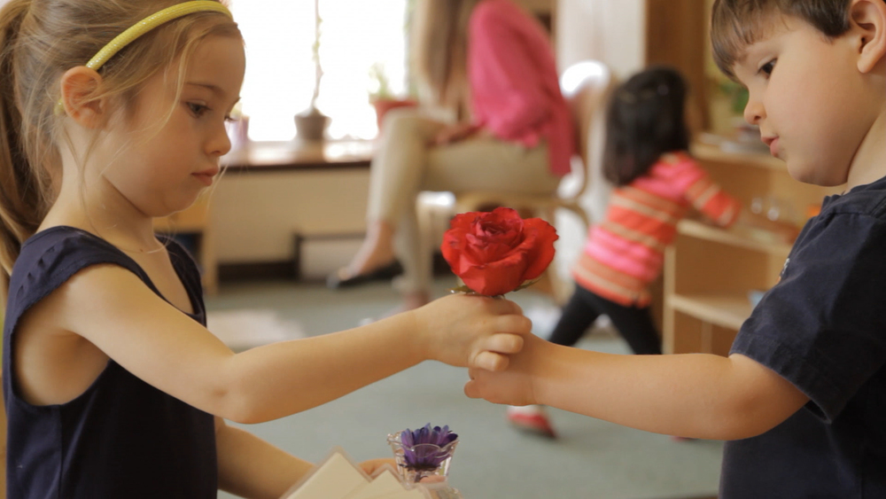
PEER GROUP AS AN AGENT OF SOCIALIZATION
Neighbourhood and schools provide a variety of peer groups.
Peers are an important source of emotional support and companionship, but peer pressure can induce individuals to behave in ways they might ordinarily regard as wrong.

Slide 13
MASS MEDIA AS AN AGENT OF SOCIALIZATION
The mass media are impersonal communication aimed at a vast audience.
Mass media arise as a technology (first the newspapers and then radio, television, films, and the Internet) spreads information on a mass scale.
The mass media have an enormous effect on our attitudes and behaviour, and on shaping people's opinion about issues as well as what they buy.
Where television provides lot of entertainment, at the same time it is a big agent of socialization.

Slide 14

MASS MEDIA AS AN AGENT OF SOCIALIZATION
The portrayal of human characters in different programs and in advertisements on television helps in projecting the gender perceptions pre
valent in the society, thereby helping in gender construction.
The same programs help in shaping attitudes, values and basic orientation of people in life.

Slide 15



Slide 16
Questions:
Elucidate the role of Media as an agency of Socialization.
Describe the various agencies of socialization.

